Slide 1


Optimizing Hotel Performance Through Data Analytics
Executive Summary
The hotel industry faces declining market share and revenue due to intense competition and a lack of data-driven insights. Limited visibility into booking trends, room availability, and platform performance hinders optimal pricing and revenue capture.

Slide 2



Our Strategic Approach to Revenue Optimization
Our methodology focuses on leveraging comprehensive data analysis to unlock hidden revenue opportunities and enhance operational efficiency.
Data Collection & Analysis
Data Cleaning & Exploration
Model & Dashboard Development
Gathering historical booking and capacity data to establish a robust foundation for insights.
Identifying critical patterns in cancellations, no-shows, and booking channel performance.
Building a dynamic data model and interactive dashboard for real-time KPI tracking and strategic insights.

Slide 3
Tools and Technologies Utilized
Python for Advanced Analytics
Power BI for Interactive Dashboards
Pandas & NumPy: For efficient data manipulation and numerical operations.
Data Modeling: Structuring data for optimal performance and insight generation.
Matplotlib & Plotly: For initial trend analysis and dynamic data visualization.
KPI Measurement: Defining and tracking key performance indicators with precision.
Streamlining complex data preparation and exploration, ensuring data quality.
Creating intuitive and actionable dashboards for strategic decision support.

Slide 4
Title: Metrics Used for Analysis
Revenue
Total Bookings
Total Capacity
Total revenue generated from bookings.
Total number of bookings recorded.
Total number of rooms available for sale.
Successful Bookings
Occupancy %
Average Rating
Number of completed bookings.
Percentage of available rooms booked.
Customer satisfaction score after stays.
Cancellation %
No-Show Rate %
Booking % by Platform
Percentage of bookings canceled.
Percentage of customers who booked but didn’t show up.
Contribution of each booking platform to total bookings.
Booking % by Room Class
ADR (Average Daily Rate)
RevPAR (Revenue Per Available Room)
Share of bookings by room category.
Average price paid per booked room.
Revenue generated for each available room.
Realization %
DBRN, DSRN, DURN
WoW Change Metrics
Percentage of bookings successfully utilized.
Daily booked, sellable, and utilized room nights.
Week-over-week changes in Revenue, Occupancy, ADR, RevPAR, and other KPIs.

Slide 5
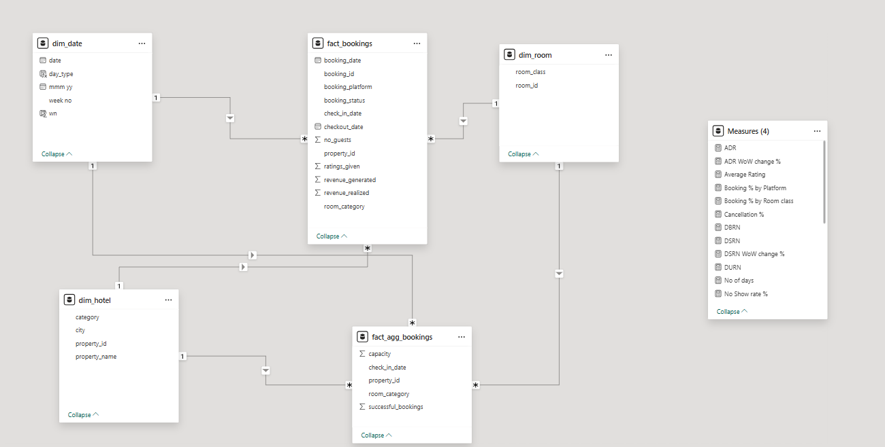
Data Modelling - Star Schema

